Slide 1
Cuda application-Case study
115/11/07

Slide 2
Introduction (1)
The fast increasing power of the GPU (Graphics Processing Unit) and its streaming architecture opens up a range of new possibilities for a variety of applications.
Previous work on GPGPU (General-Purpose computation on GPUs) have showed the design and implementation of algorithms for non-graphics applications. (scientific computing, computational geometry, image processing, Bioinformatics and etc.)
GPU Workshop
115/11/07

Slide 3
Introduction (2)
Some bioinformatics applications have been successfully ported to GPGPU in the past.
  Liu et al. (IPDPS 2006) implemented the Smith-Waterman algorithm to run on the nVidia GeForce 6800 GTO and GeForce 7800 GTX, and reported an approximate 16× speedup by computing the alignment score of multiple cells simultaneously.
  Charalambous et al. (LNCS 2005) ported an expensive loop from RAxML, an application for phylogenetic tree construction, and achieved a 1.2× speedup on the nVidia GeForce 5700 LE.
GPU Workshop
115/11/07

Slide 4
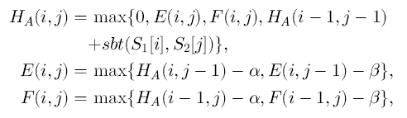
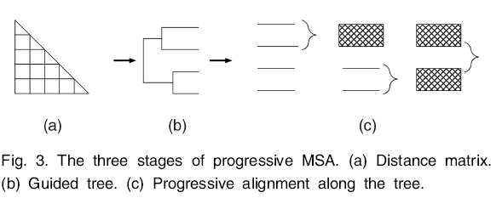
Introduction (3)
Liu et al. (IEEE TPDS 2007) presented a GPGPU approach to high-performance biological sequence alignment based on commodity PC graphics hardware. (C++ and OpenGL Shading Language (GLSL))
  Pairwise Sequence Alignment (Smith-Waterman algorithm, scan database)
  Multiple sequence alignment (MSA)
(from Liu et al. TPDS 2007)
(from Liu et al. TDPS 2007)
GPU Workshop
115/11/07

Slide 5
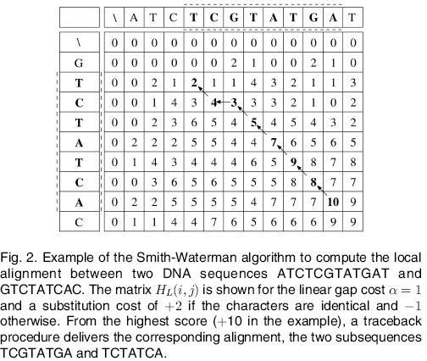
(from Liu et al. TPDS 2007)
GPU Workshop
115/11/07

Slide 6
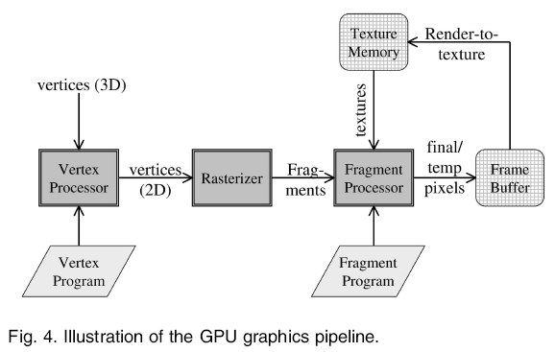
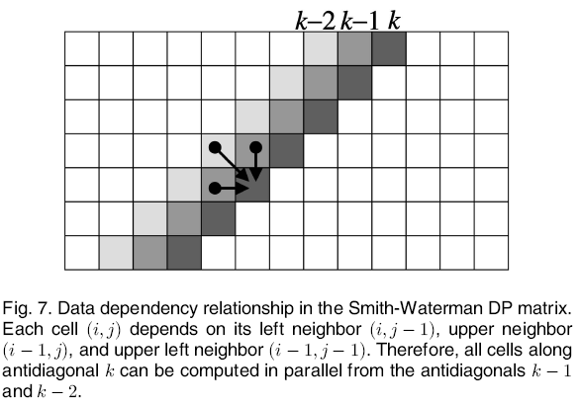
(from Liu et al. TDPS 2007)
(no traceback)
GPU Workshop
(from Liu et al. TPDS 2007)
115/11/07

Slide 7
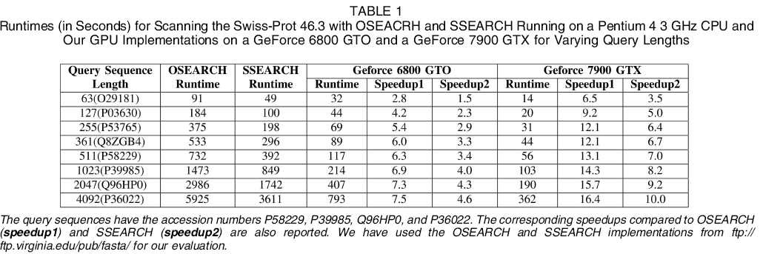
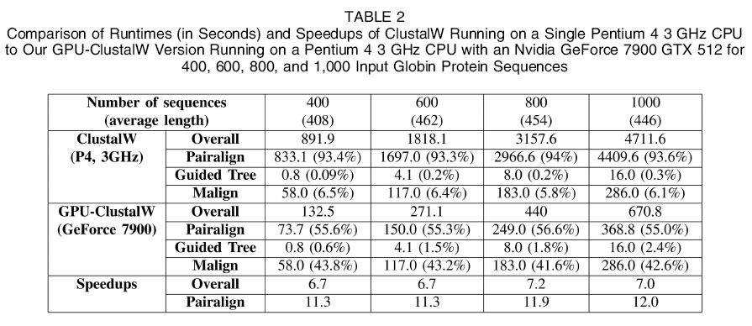
(from Liu et al. TDPS 2007)
(from Liu et al.
TDPS 2007)
GPU Workshop
115/11/07

Slide 8
Introduction (4)
CUDA (Compute Unified Device Architecture) is an extension of C/C++ which enables users to write scalable multi-threaded programs for CUDA-enabled GPUs.
  CUDA programs contain a sequential part, called a kernel.
  Readable and writable global memory (ex. 1GB)
  Readable and writable per-thread local memory (16KB per thread)
  Read-only constant memory (64KB, cached)
  Read-only texture memory (size of global, cached)
  Readable and writable per-block shared memory (16KB per block)
  Readable and writable per-thread registers (8192 per block)
GPU Workshop
115/11/07

Slide 9
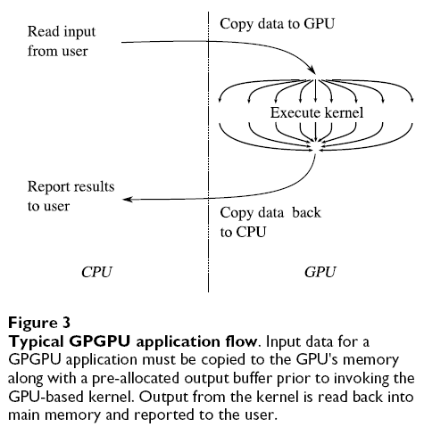
Grid
Block (0, 0)
Block (1, 0)
Shared Memory
Shared Memory
Registers
Registers
Registers
Registers
Thread (0, 0)
Thread (1, 0)
Thread (0, 0)
Thread (1, 0)
Local
Memory
Local
Memory
Local
Memory
Local
Memory
(from Schatz et al. BMC Bioinformatics 2007)
Host
Global
Memory
Constant
Memory
© David Kirk/NVIDIA and Wen-mei W. Hwu, 2007
ECE 498AL, University of Illinois, Urbana-Champaign
Texture
Memory
GPU Workshop
115/11/07

Slide 10
Introduction (5)
Some bioinformatics applications have been successfully ported to CUDA now.
  Smith-Waterman algorithm (goal: scan database)
    Manavski and Valle (BMC Bioinformatics 2008), Ligowski and Rudnicki (University of Warsaw), Striemer and Akoglu (IPDPS 2009), Liu et al. (BMC Research Notes 2009)
  Multiple sequence alignment (ClustalW)
    Liu et al. (IPDPS 2009) for Neighbor-Joining Trees construction
    Liu et al. (ASAP 2009)
  Pattern matching (MUMmer)
    Schatz et al. (BMC Bioinformatics 2007)
GPU Workshop
115/11/07

Slide 11
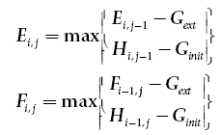
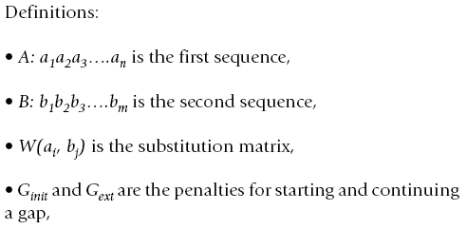
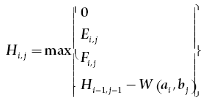
Smith-Waterman algorithm (1)
Manavski and Valle present the first solution based on commodity hardware that efficiently computes the exact Smith-Waterman alignment. It runs from 2 to 30 times faster than any previous implementation on general-purpose hardware.
(from Schatz et al. BMC Bioinformatics 2007)
GPU Workshop
115/11/07

Slide 12
Smith-Waterman algorithm (2)
  Pre-compute a query profile parallel to the query sequence for each possible residue.
  The implementation in CUDA was to make each GPU thread compute the whole alignment of the query sequence with one database sequence. (pre-order the sequences of the database in function of their length)
  The ordered database is stored in the global memory, while the query-profile is saved into the texture memory.
  For each alignment the matrix is computed column by column in order parallel to the query sequence. (store them in the local memory of the thread)
GPU Workshop
115/11/07

Slide 13
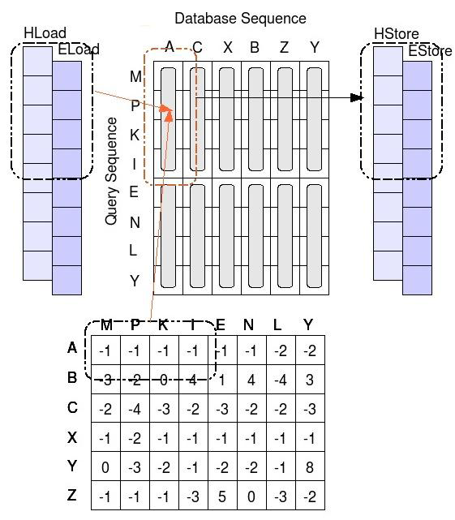
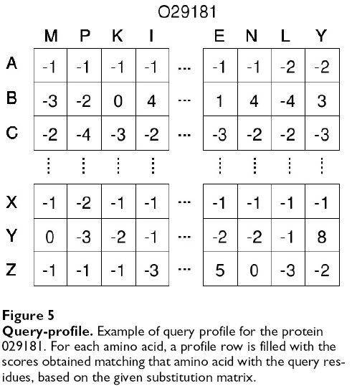
(no traceback)
(from Schatz et al. BMC Bioinformatics 2007)
GPU Workshop
115/11/07
(from Schatz et al. BMC Bioinformatics 2007)

Slide 14
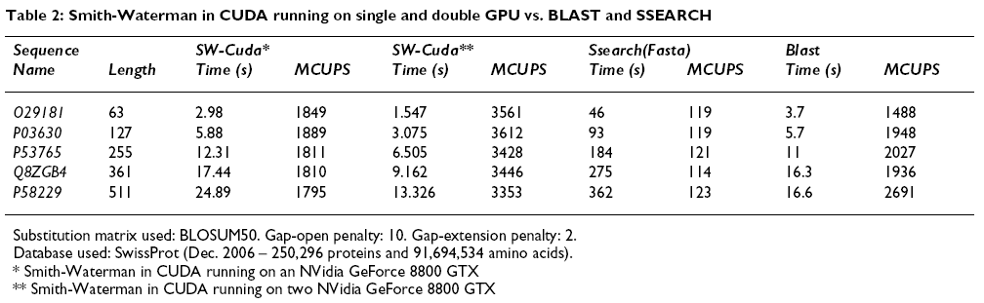
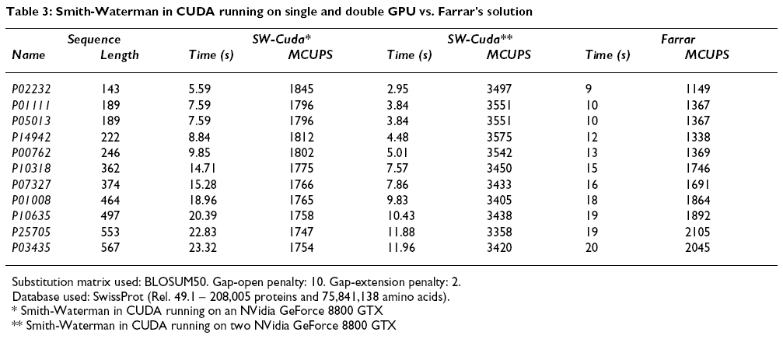
(from Schatz et al. BMC Bioinformatics 2007)
(from Schatz et al. BMC Bioinformatics 2007)
GPU Workshop
115/11/07

Slide 15
Smith-Waterman algorithm (3)
Striemer and Akoglu further study the effect of memory organization and the instruction set architecture on GPU performance.
  For both single and dual GPU configurations, Manavski utilizes the help of an Intel Quad Core processor by distributing the workload among GPU(s) and the Quad Core processor.
  They pointed out that query profile in Manavski’s method has a major drawback in utilizing the texture memory of the GPU that leads to unnecessary caches misses. (larger than 8KB)
  Long sequence problem.
GPU Workshop
115/11/07

Slide 16
Smith-Waterman algorithm (4)
  They placed the substitution matrix in the constant memory to exploit the constant cache, and created an efficient cost function to access it. (modulo operator is extremely inefficient on CUDA, not use hash function)
    The substitution matrix needs to be re-arranged in alphabetical order.
  They mapped query sequence as well as the substitution matrix to the constant memory.
  They pointed out the main drawback of GPU is the limited on chip memory. (need to be designed carefully)
GPU Workshop
115/11/07

Slide 17
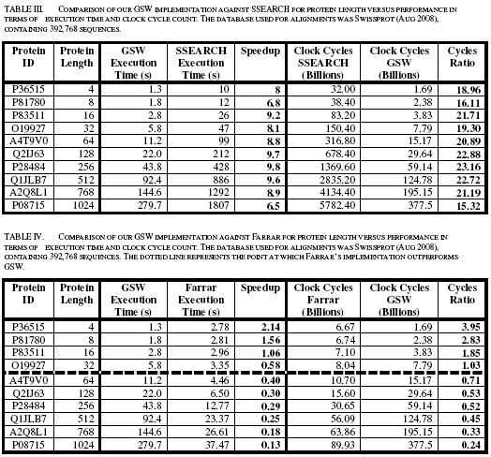
GPU Workshop
115/11/07
(from Striemer and Akoglu IPDPS 2009)

Slide 18
Smith-Waterman algorithm (5)
Liu et al. proposed Two versions of CUDASW++ are implemented: a single-GPU version and a multi-GPU version.
  The alignment can be computed in minor-diagonal order from the top-left corner to the bottom-right corner in the alignment matrix.
  Considering the optimal local alignment of a query sequence and a subject sequence as a task.
    Inter-task parallelization: Each task is assigned to exactly one thread and dimBlock tasks are performed in parallel by different threads in a thread block.
    Intra-task parallelization: Each task is assigned to one thread block and all dimBlock threads in the thread block cooperate to perform the task in parallel.
GPU Workshop
115/11/07

Slide 19
Smith-Waterman algorithm (6)
  Inter-task parallelization occupies more device memory but achieves better performance than intra-task parallelization.
  Intra-task parallelization occupies significantly less device memory and therefore can support longer query/subject sequences. (two stages implementation)
  In order to achieve high efficiency for inter-task parallelization, the runtime of all threads in a thread block should be roughly identical. (re-order database sequences)
GPU Workshop
115/11/07

Slide 20
Smith-Waterman algorithm (7)
Coalesced subject sequence arrangement
  Sorted subject sequences for the intra-task parallelization are sequentially stored in an array row by row from the top-left corner to the bottom-right corner. (A hash table records the location coordinate in the array and the length of each sequence, providing fast access to any sequence)
Coalesced global memory access
  During the execution of the SW algorithm, additional memory is required to store intermediate alignment data. (A prerequisite for coalescing is that the words accessed by all threads in a half-warp must lie in the same segment)
GPU Workshop
115/11/07

Slide 21
Smith-Waterman algorithm (8)
Cell block division method
  To maximize performance and to reduce the bandwidth demand of global memory, they propose a cell block division method for the inter-task parallelization, where the alignment matrix is divided into cell blocks of equal size. (padded with an appropriate number of dummy symbols)
Constant memory is exploited to store the gap penalties, scoring matrix and the query sequence. (In our implementation, sequences of length up to 59K can be supported)
GPU Workshop
115/11/07

Slide 22
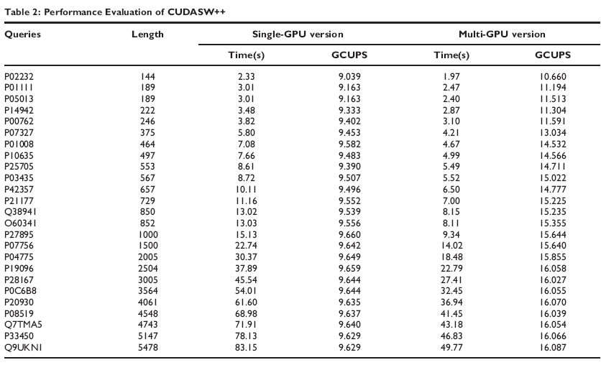
a single-GPU NVIDIA GeForce GTX 280 graphics card and a dual-GPU GeForce GTX 295 graphics card
(from Liu et al. BMC Research Notes 2009)
GPU Workshop
115/11/07

Slide 23
Multiple sequence alignment
Liu et al. presents MSA-CUDA, a parallel MSA program, which parallelizes all three stages of the ClustalW processing pipeline using CUDA.
  Pairwise distance computation:
    a forward score-only pass using Smith-Waterman (SW) algorithm
    a reverse score-only pass using SW algorithm
    a traceback computation pass using Myers-Miller algorithm
    they have developed a new stack-based iterative implementation. (CUDA does not support recursion)
    As the work in Liu et al. (BMC Research Notes 2009)
  Neighbor-Joining Trees: as the work in Liu et al. (IPDPS 2009)
  Progressive alignment: conducted iteratively in a multi-pass way.
GPU Workshop
115/11/07

Slide 24
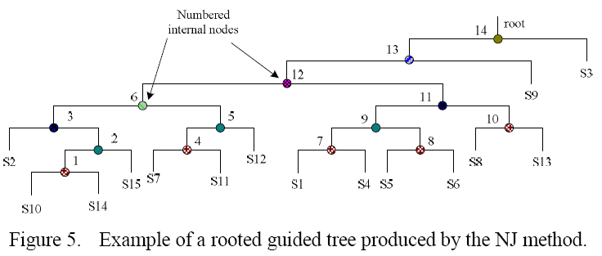
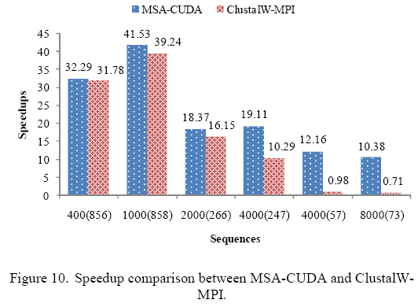
    (from Liu et al. ASAP 2009)
    (from Liu et al. ASAP 2009)
GPU Workshop
115/11/07

Slide 25
Pattern matching (1)
Schatz et al. proposed MUMmerGPU, an open-source high-throughput parallel pairwise local sequence alignment program (exact sequence alignment) that runs on commodity Graphics Processing Units (GPUs) in common workstations.
MUMmerGPU uses the new Compute Unified Device Architecture (CUDA) from nVidia to align multiple query sequences against a single reference sequence stored as a suffix tree.
GPU Workshop
115/11/07

Slide 26
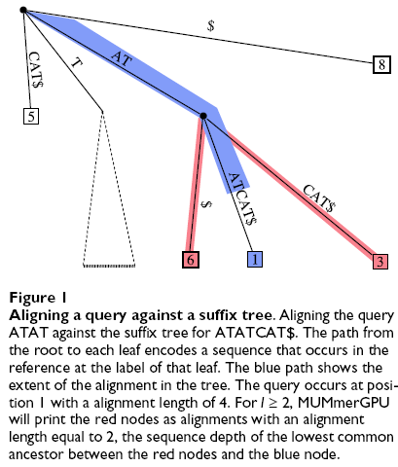
(from Schatz et al. BMC Bioinformatics 2007)
GPU Workshop
115/11/07

Slide 27
Pattern matching (2)
  First a suffix tree of the reference sequence is constructed on the CPU using Ukkonen's algorithm and transferred to the GPU. (the reference suffix tree, query sequences, and output buffers will fit on the GPU)
    MUMmerGPU builds k smaller suffix trees from overlapping segments of the reference. The suffix tree is "flattened" into two 2D textures, the node texture and the child texture.
    The queries are read from disk in blocks that will fill the remaining memory, concatenated into a single large buffer (separated by null characters), and transferred to the GPU. An auxiliary 1D array, also transferred to the GPU, stores the offset of each query in the query buffer.
  Then the query sequences are transferred to the GPU, and are aligned to the tree on the GPU using the alignment algorithm.
GPU Workshop
115/11/07

Slide 28
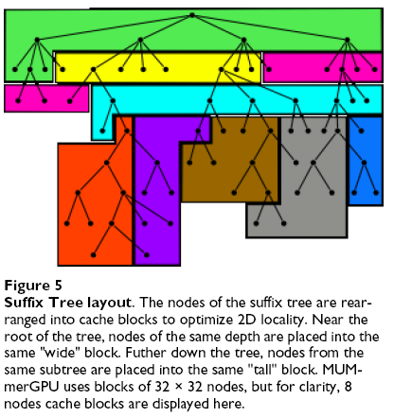
(from Schatz et al. BMC Bioinformatics 2007)
GPU Workshop
115/11/07

Slide 29
Pattern matching (3)
    Each multiprocessor on the GPU is assigned a subset of queries to process in parallel, depending on the number of multiprocessors and processors available.
    Thus, the data reordering scheme attempts to increase the cache hit rate for a single thread
  Alignment results are temporarily written to the GPU's memory, and then transferred in bulk to host RAM once the alignment kernel is complete for all queries. (the alignments are printed by the CPU)
GPU Workshop
115/11/07

Slide 30
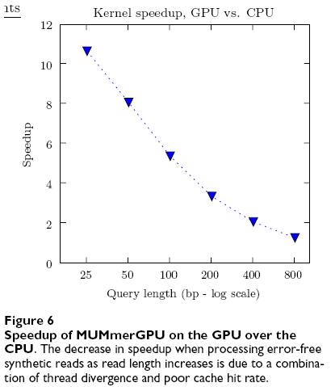
The time for building the suffix tree, reading queries from
disk, and printing alignment output is the same regardless of whether MUMmerGPU ran on the CPU or the GPU
(from Schatz et al. BMC Bioinformatics 2007)
GPU Workshop
115/11/07

Slide 31
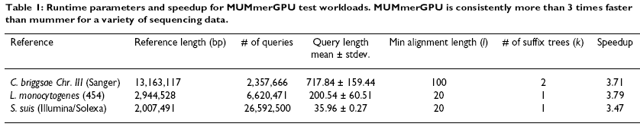
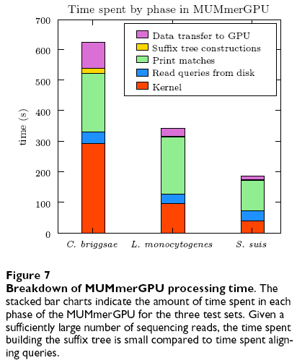
(from Schatz et al. BMC Bioinformatics 2007)
(from Schatz et al. BMC Bioinformatics 2007)
GPU Workshop
115/11/07

